Slide 1
Diamond Price Prediction
Rutik Dhavale

Slide 2
Agenda
Project Goal
Dataset
Data Pre-processing
Descriptive Analysis
Predictive Analysis
Result & Conclusion

Slide 3
Project Goal
The goal of the projects is to build a model that can accurately predict the price of a diamond by given measurements.

Slide 4
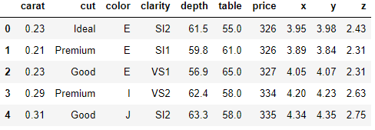
Dataset There are total 10 columns in the dataset & price is our label.

Slide 5
Dataset Content:
price price in US dollars (326−−326−−18,823)
carat weight of the diamond (0.2--5.01)
cut quality of the cut (Fair, Good, Very Good, Premium, Ideal)
color diamond colour, from J (worst) to D (best)
clarity a measurement of how clear the diamond is (I1 (worst), SI2, SI1, VS2, VS1, VVS2, VVS1, IF (best))
x length in mm (0--10.74)
y width in mm (0--58.9)
z depth in mm (0--31.8)
depth total depth percentage = z / mean(x, y) = 2 * z / (x + y) (43--79)
table width of top of diamond relative to widest point (43—95)

Slide 6
Data Pre-processing
Handling the Categorical data
Outlier Resolution
Handling Missing values

Slide 7
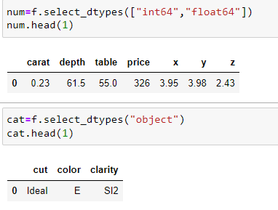
Categorical Data Cut, Colour & Clarity are the categorical features in the dataset.

Slide 8
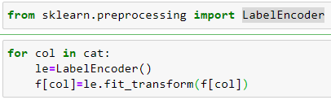
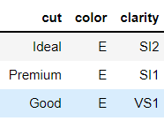
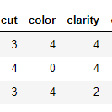
By Encoding technique we are handling the categorical data. In this data we convert the categorical data into numerical by using Label Encoder.

Slide 9
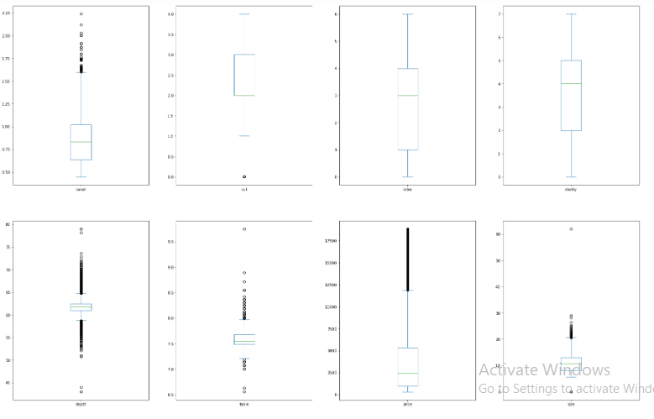
Outlier Resolution
By using the box we check & remove the outliers in the data set.
By using boxplot, In Carat, Size, price & depth columns outlier are present.

Slide 10
Missing values
By using pandas library we check the missing values in the dataset.
In this data set there are no missing values
We check the null values by→ pandas .isnull().any() & we found zero. So we say that no missing values in the dataset.

Slide 11
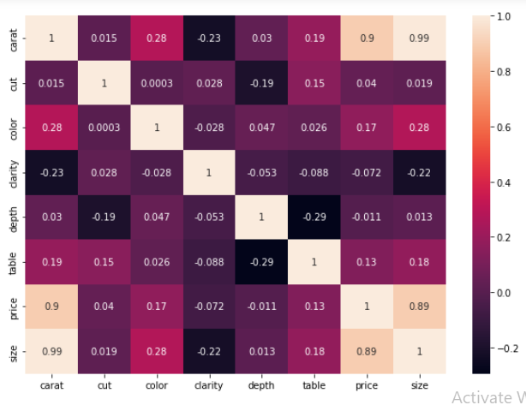
Descriptive Analysis
Correlation-by using the heatmap

Slide 12
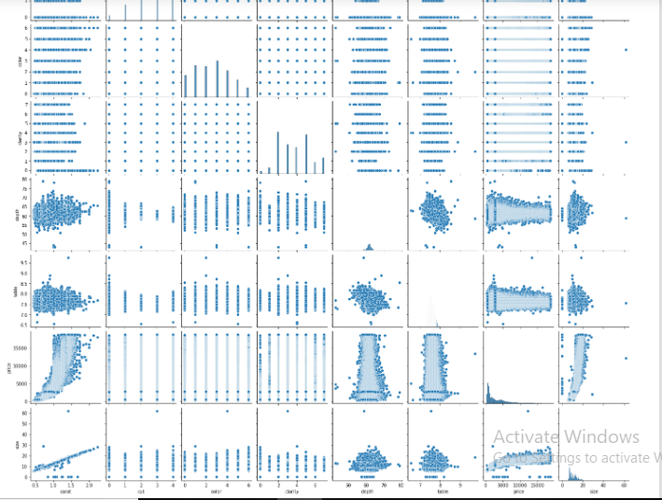
Multivariate correlation between features & label.

Slide 13
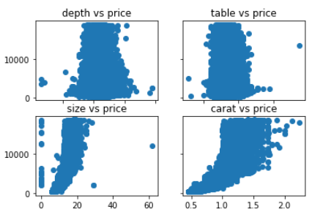
By using scatter plot we check the relation between feature and label

Slide 14
Predictive Analysis
Selection of feature and label.
Splitting data into train & test.
Selection of Model.
Fit the model .
Prediction.

Slide 15
Result & conclusion:
The best mode gives the 0.83 r2_score.
Mean Absolute Error: 1203.7477544734534
Mean Square Error: 2580553.6677713445
Root Mean Square Error: 1606.4101804244594
So our model is good.

Slide 16
Thank You !

